Slide 1

“insert a motivational quotes that can be use as our tagline”

Slide 2


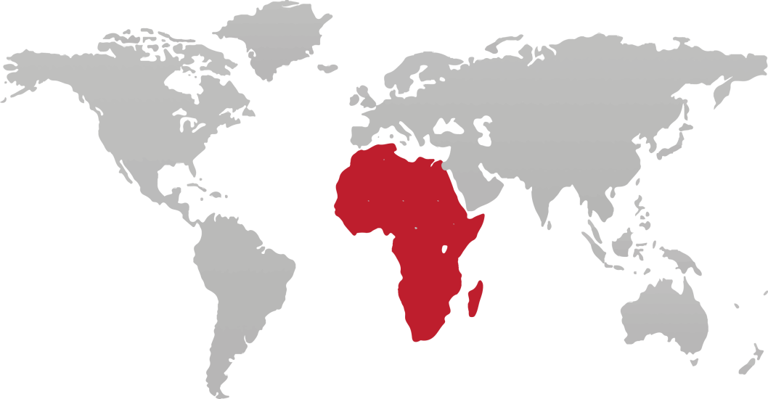
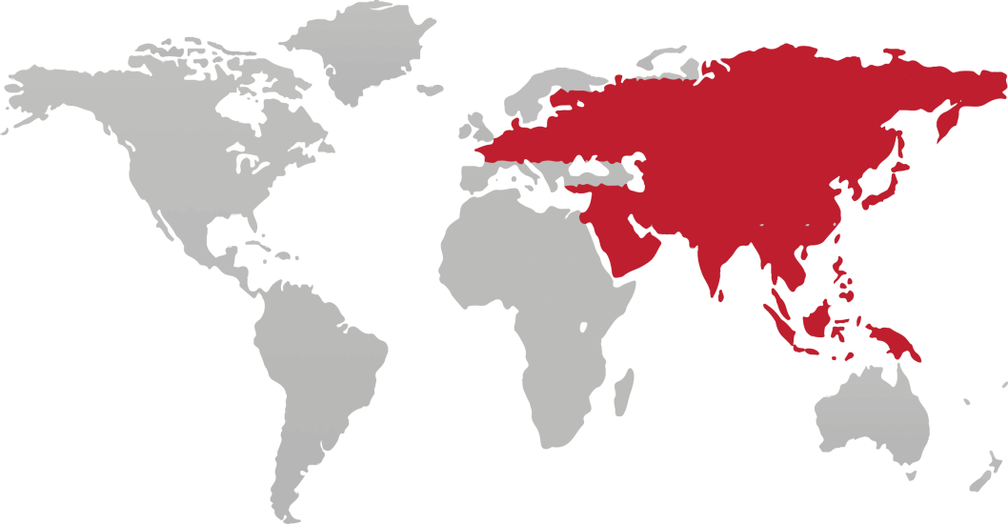


Did you know?
1
Out of
9
Why we are talking about food
About 805 million of 7.3 billion people in the world, suffering from chronic undernourishment in 2012 -2014
Asia
525.6 million
Africa
226.7 million
Oceania
1.4 million
Latin America & Carib
37 million
Source: www.worldhunger.org

Slide 3
Our goal
What we want to achieve
Goal
Problem statement
Why Insect?
Logic Model
To provide society with healthy, sustainable and delicious source of food
Industrialization of insect as food
Healthy
Ecological friendly
People
Inputs
Outputs
Outcomes

Slide 4

Logic model
Identifying all the data needed
Inputs
Outputs
Outcomes
Funding
Existing knowledge
Industrial mentors
Internet network
Software & tools
Training session
Previous & personal experience from team
Prototype of insect farm / product related
Published report & website
Good grades ☺
Performance report of teamwork
To have a wrap up information for the community
To introduce new knowledge of alternative food
To learn how to analyze and write industrial report
To expand networking
To get technical skill
People:
Team member
Classmate
Those who related to insect community

Slide 5
Thank you!

